Slide 1
Contributions of intermolecular attractions to $U(T,V)$
It’s an uphill climb to overcome these attractions when molecules move away from each other.
Intermolecular attractions

Slide 2
Contributions of intermolecular attractions to $U(T,V)$
It’s an uphill climb to overcome these attractions when molecules move away from each other.
That happens when the volume expands.
Intermolecular attractions

Slide 3
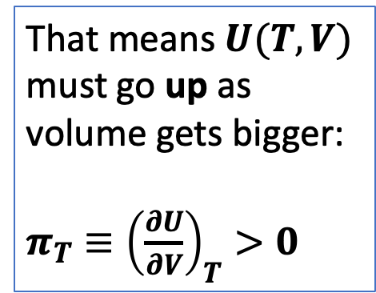
Contributions of intermolecular attractions to $U(T,V)$
Intermolecular attractions
That means $U(T,V)$ must go up as volume gets bigger:
${π_{T}≡\left(\frac{∂U}{∂V}\right)}_{T}>0$

Slide 4
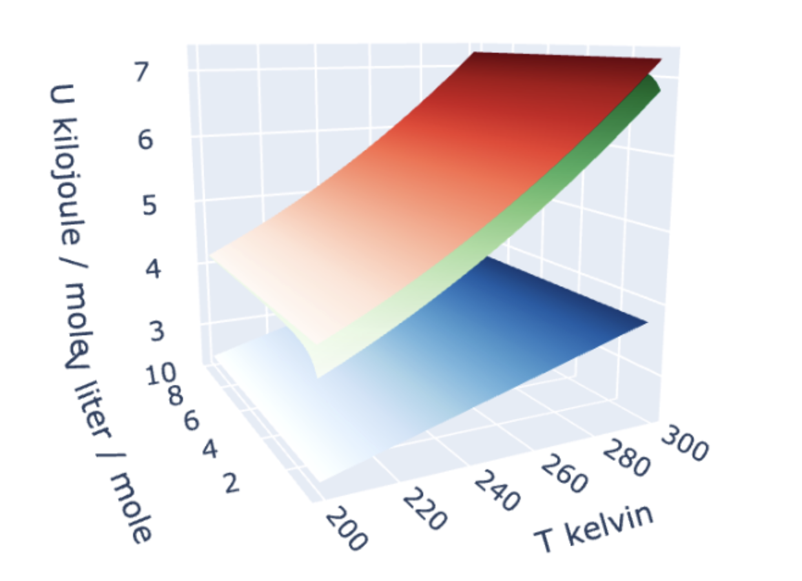
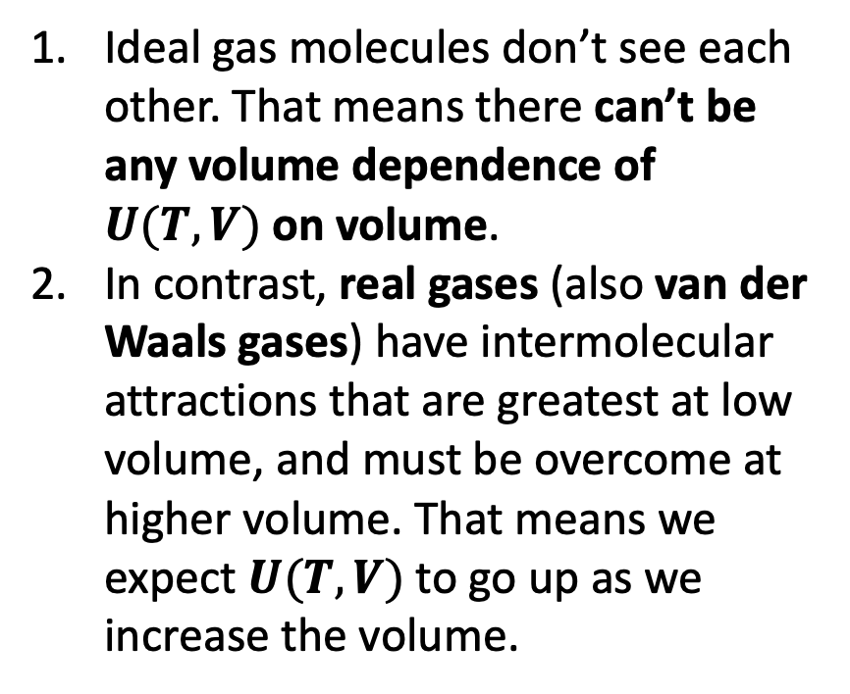
Summarizing the volume dependence of $U(T,V)$
Ideal gas molecules don’t see each other. That means there can’t be any volume dependence of $U(T,V)$on volume.
In contrast, real gases (also van der Waals gases) have intermolecular attractions that are greatest at low volume, and must be overcome at higher volume. That means we expect $U(T,V)$to go up as we increase the volume.

Slide 5
Summarizing the volume dependence of $U(T,V)$
Based on that, which gases could be real, which could be ideal?
Ideal gas molecules don’t see each other. That means there can’t be any volume dependence of $U(T,V)$on volume.
In contrast, real gases (also van der Waals gases) have intermolecular attractions that are greatest at low volume, and must be overcome at higher volume. That means we expect $U(T,V)$to go up as we increase the volume.

Slide 6
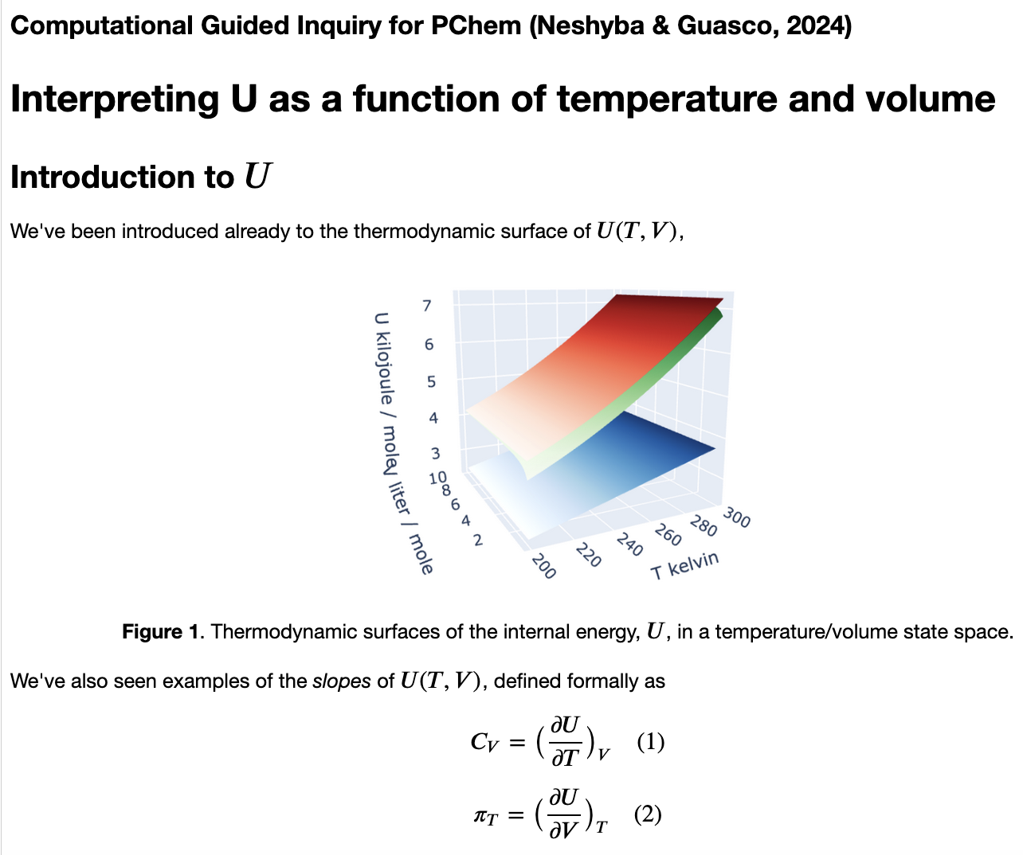
We get into all of this in Interpreting U

